Slide 1
TEAM 13 LOOP PROBLEM STATEMENT
Bhargav Vijay Gautham
Shivam Abhijna Meghana

Slide 2

Challenge Statement
To eliminate manual process of Loop coordinates visiting the schools.
To eliminate multiple stakeholders due to delay in planning.
to eliminate underutilization of resources.
Automated all manual processing involve today

Slide 3
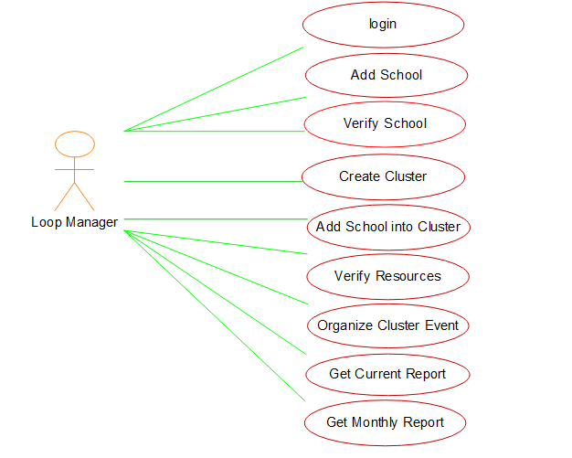
Case diagrams

Slide 4
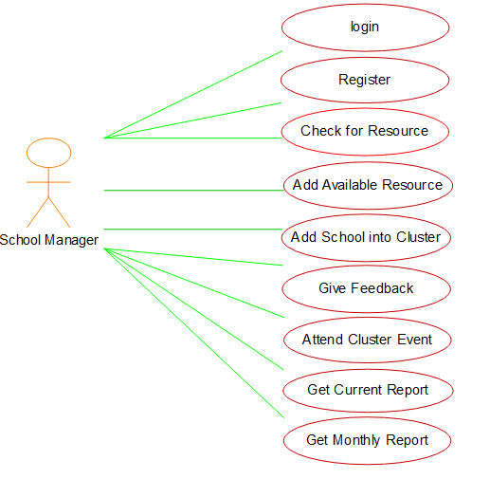

Slide 5


Technology stack
Php (backend)
Mysql (database)
Html, css, javascript, jquery (font-end )
Bootstrap
AGILE Methodology was followed

Slide 6
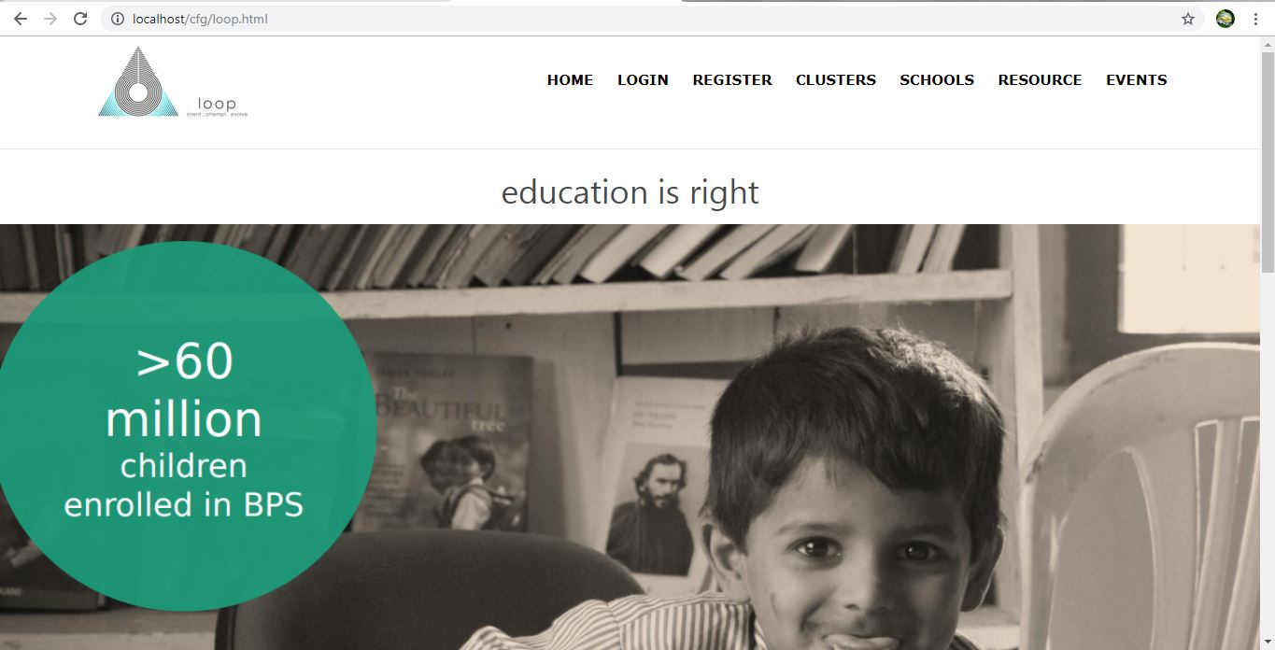
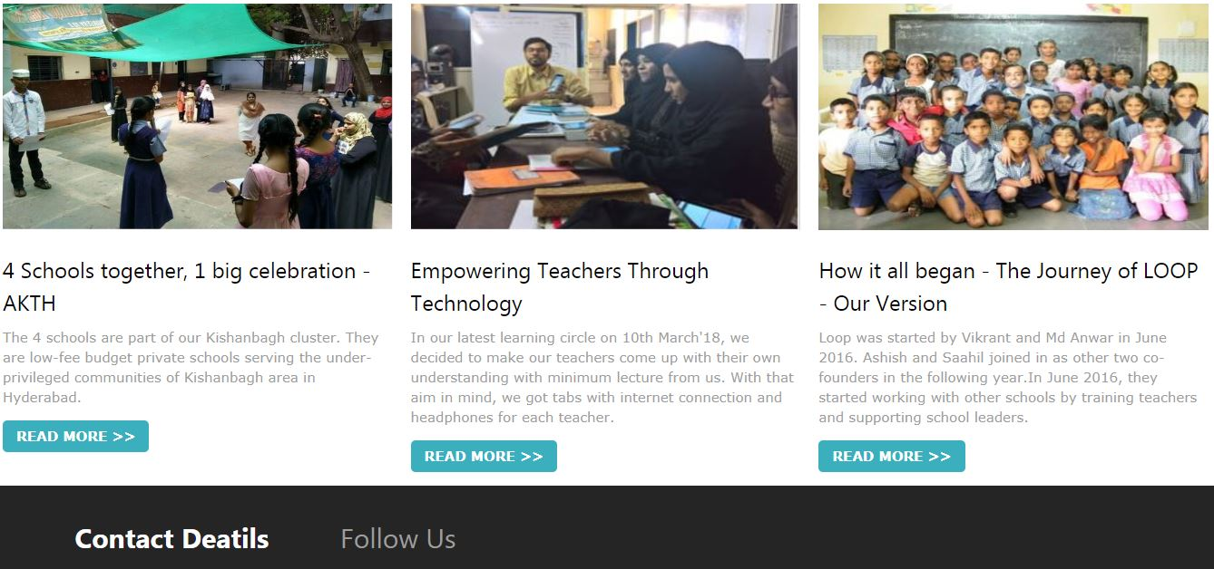
HOME PAGE

Slide 7
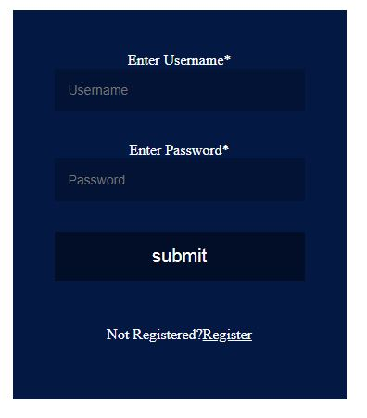
Features
Sign up and login for beneficiaries

Slide 8
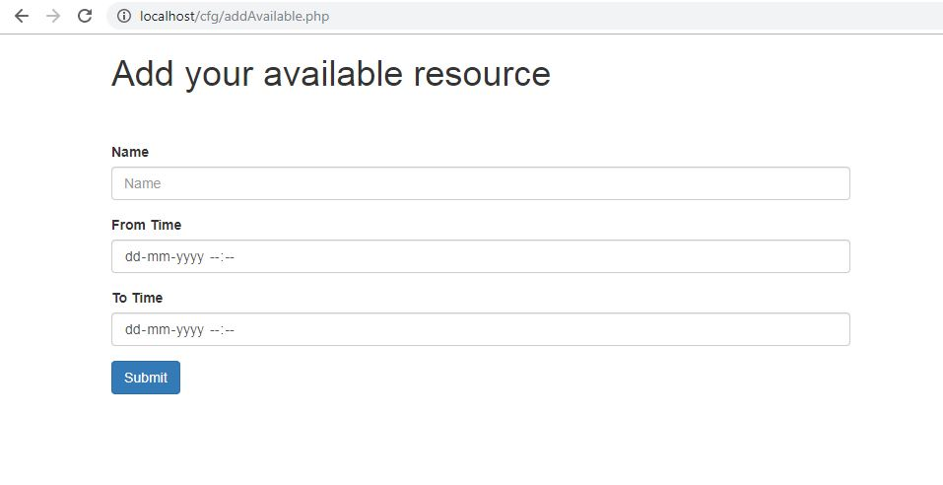
Schools can add available resources

Slide 9
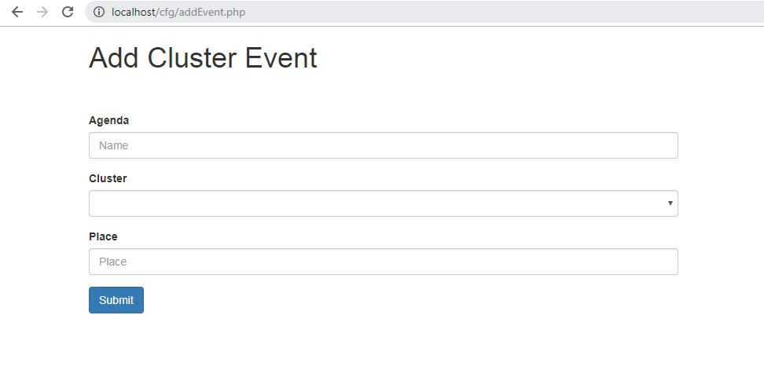
Loop TEAM CAN ADD cluster level events

Slide 10
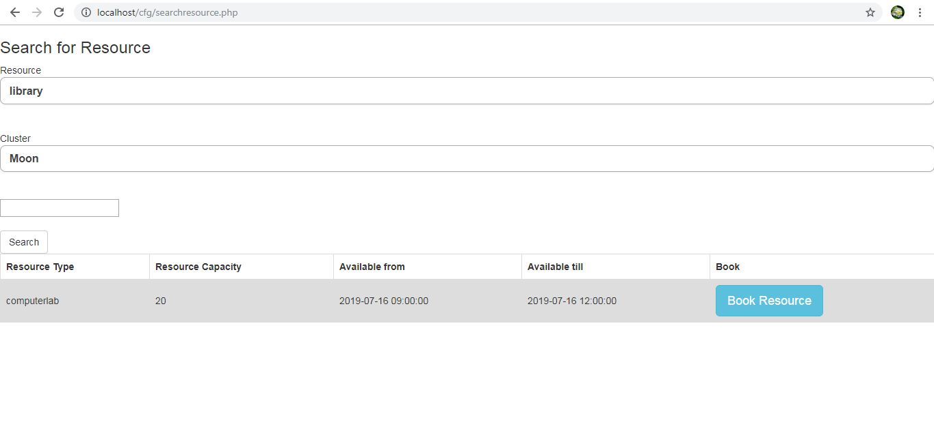
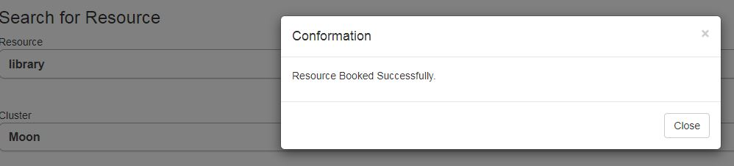
Schools can search and book resources

Slide 11
FUTURE SCOPE
Google map integration for location updates.
Filters with easy ui for resource booking.
Best searching criteria algorithms for resource booking – machine learning.
Predictive analytics to forecast bookings.

Slide 12
THANK YOu
BY
TEAM 13

